Slide 1
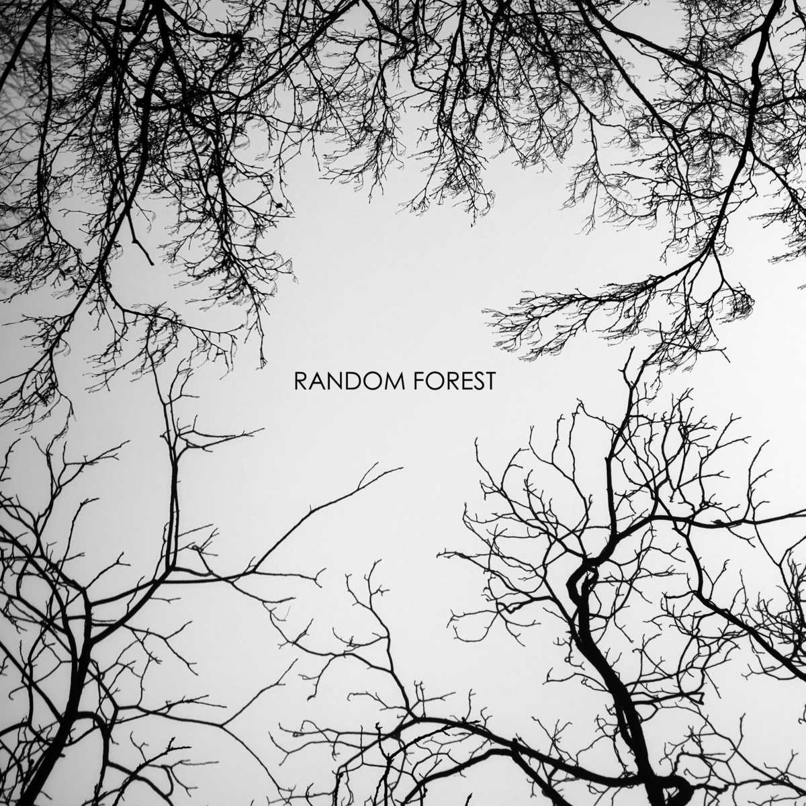


Slide 2

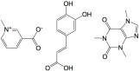
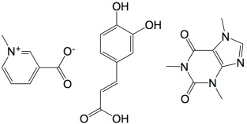

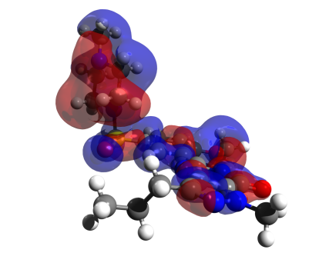
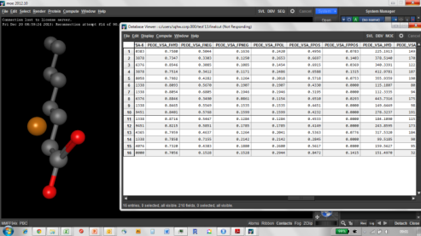
Reported activity
#Molecule/effect
#1/57%
#2/22%
#3/81%
…
Forecast
machine
#541 -> 57%
#342 -> 22%
#343 -> 81%
formulas
Machine
Learning :
Learn from the machine
Simulated molcules
MLR
PCR
PLS
ridge
PCR
kNN
RF
SVM
ANN
Properties of
molecules
?

Slide 3
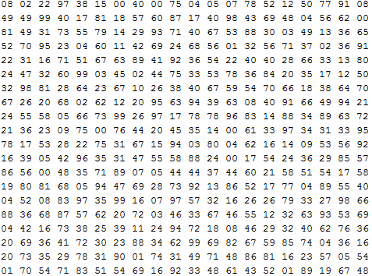


Model-fit
Supervised-learning:
GLM
PLS
Ridge
Model
kNN
Xy-train
RF
Deep
neural
nets
Parameters
P(‘Søren’)=93%

Slide 4
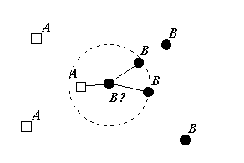
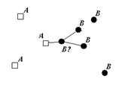
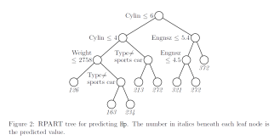
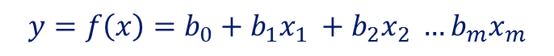
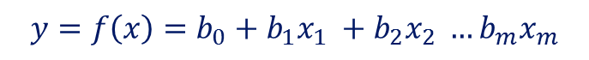
OLS
GLM
$$y=f\left(x\right)=b_{0}+b_{1}x_{1} +b_{2}x_{2} …b_{m}x_{m}$$
PLS
Ridge
“Apparent model”
PCs, constraints
$$y=f\left(x\right)=b_{0}+b_{1}x_{1} +b_{2}x_{2} …b_{m}x_{m}$$
kNN
RF

Slide 5
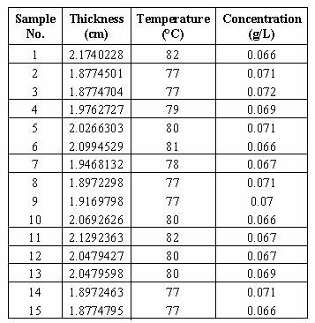

How to learn from the machine
Sample
data
Have machine
to model data
Unknown
system
Learn from
model
Bottom-up model selection
Unknown
system
Sample data
Fit explicit model e.g.
linear regression
Look at residuals
Add more terms or transformations
Test hypotheses of G
Simple model
Best model

Slide 6
Domain knowledge
of system
Few observations
Well-known system
Stick to bottom-up!
Many observations
Well-known system
Maybe for fine tuning.
N, observations
Few observations
Unknown system
Tough luck
Many observations
Unknown system
Machine Learning &
Data mining!

Slide 8
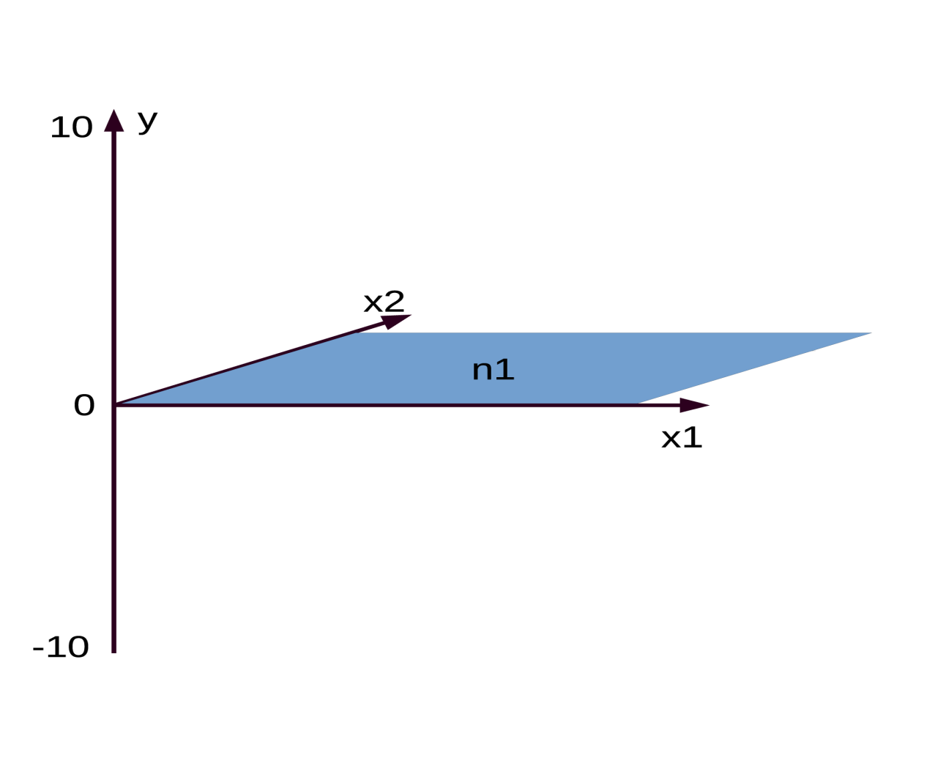
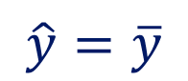
Two variables, one target, one grand mean(n1)
Mean is the prediction
$$\hat{y}=\overline{y}$$

Slide 9
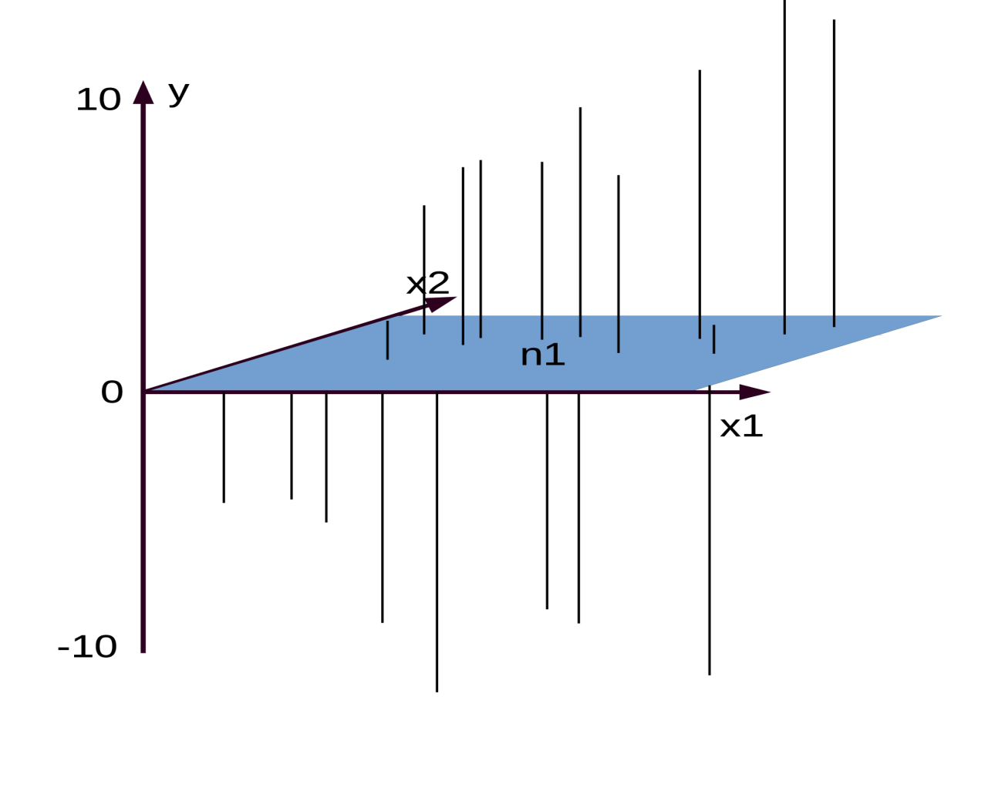
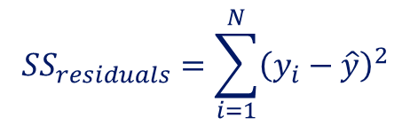
… and residuals of the grand mean
Sum of squares is error
$$SS_{residuals}=\sum_{i=1}^{N}{{\left(y_{i}−\hat{y}\right)}^{2}}$$

Slide 10
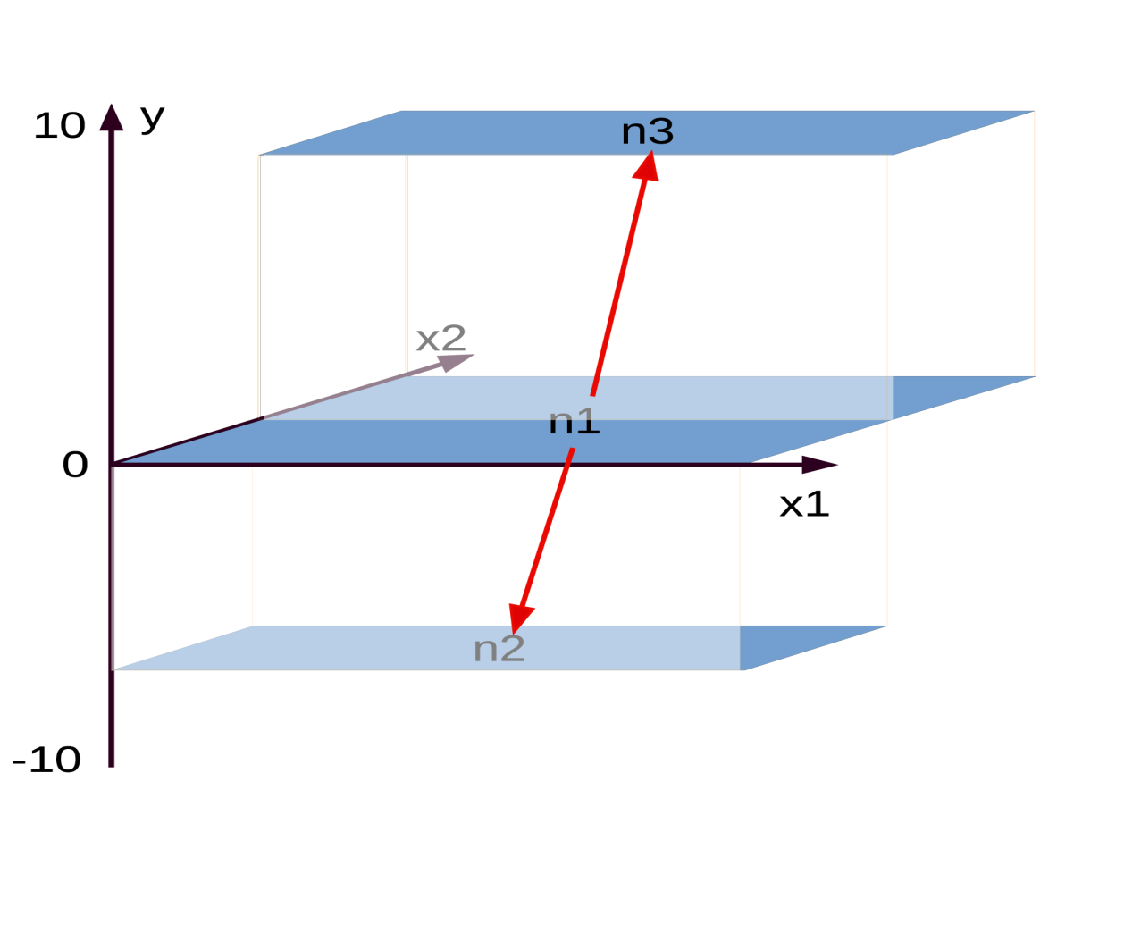
Best split of n1 by x2…
Best split gives lowest error

Slide 11
Best split of n1 by x2…
Repeat for each sub node!

Slide 12
Best split of n1 by x2…

Slide 13
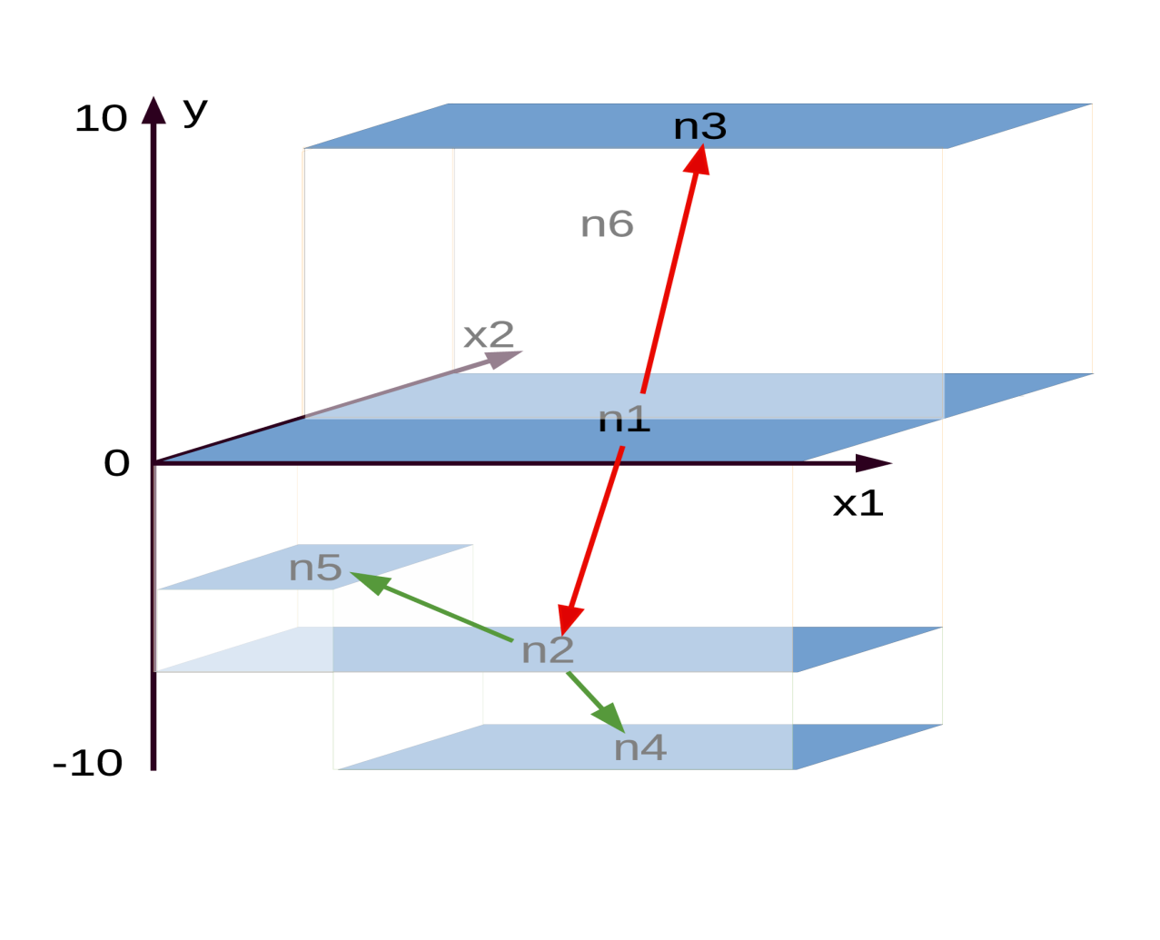
Best split of n2…

Slide 14
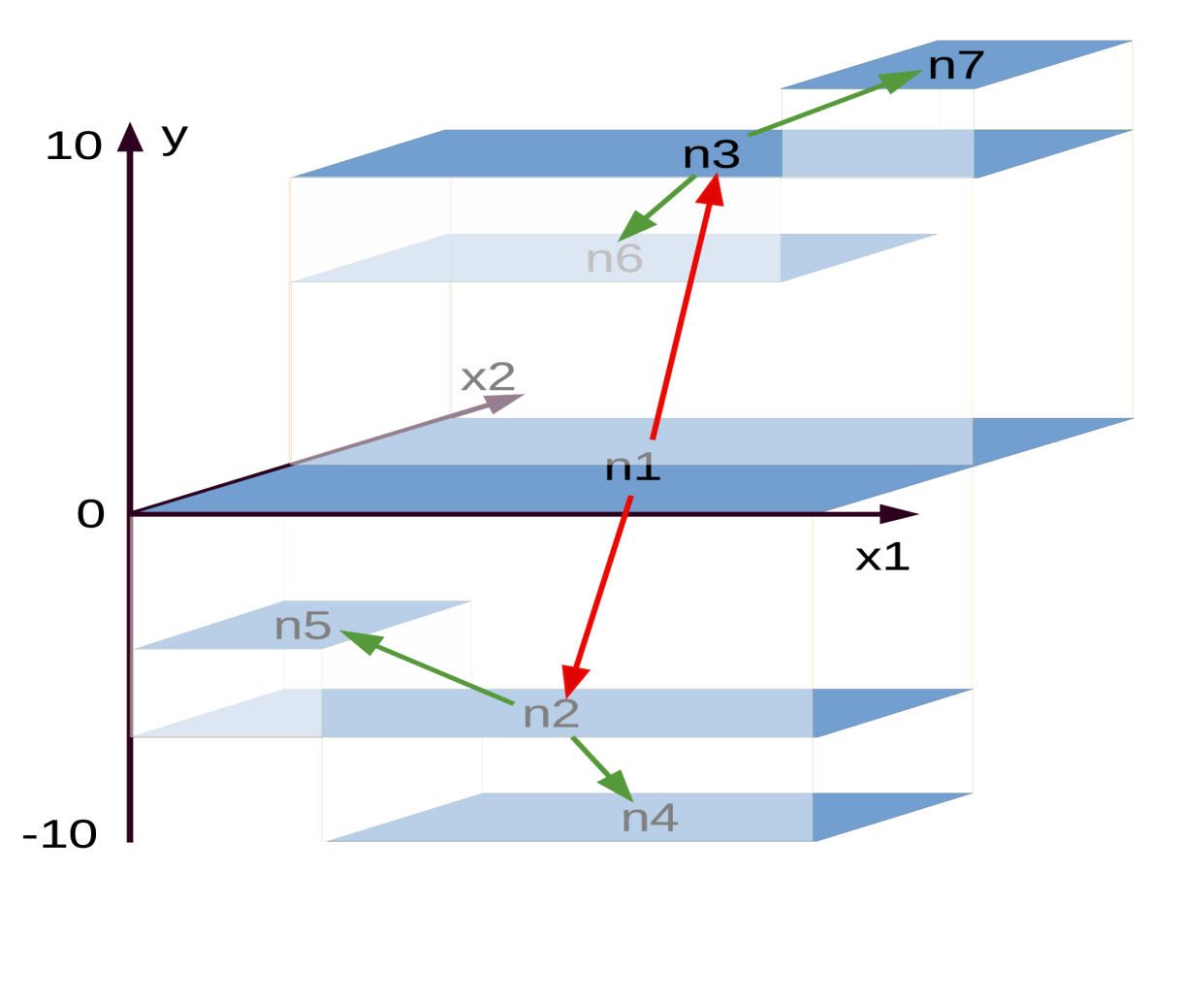
Best split of n3

Slide 15
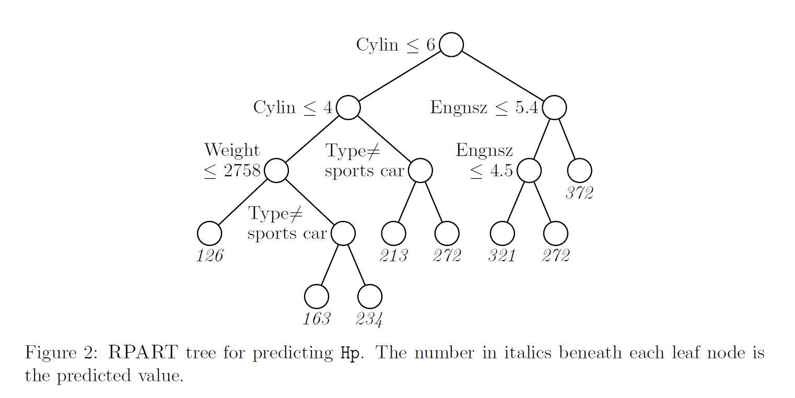

Slide 16
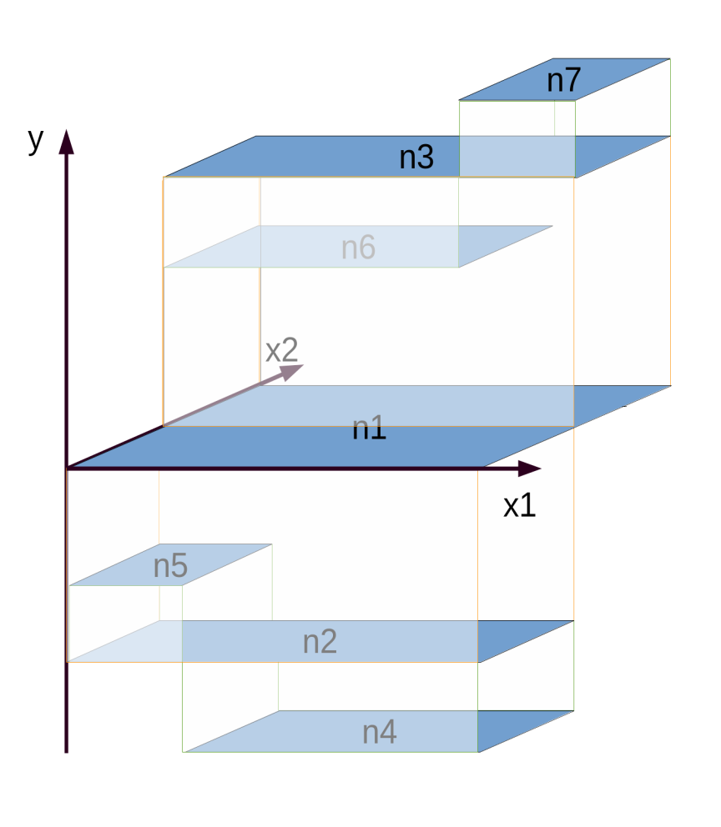
data
bootstrap

Slide 17


Slide 18
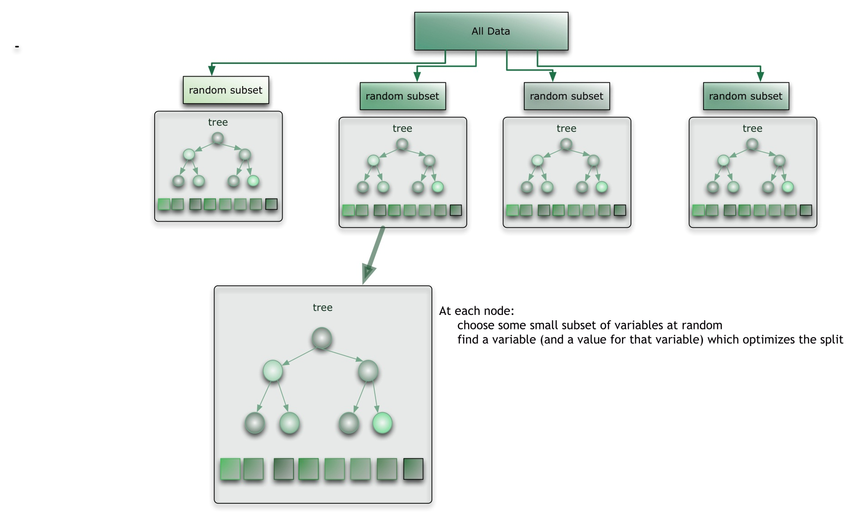

Slide 19


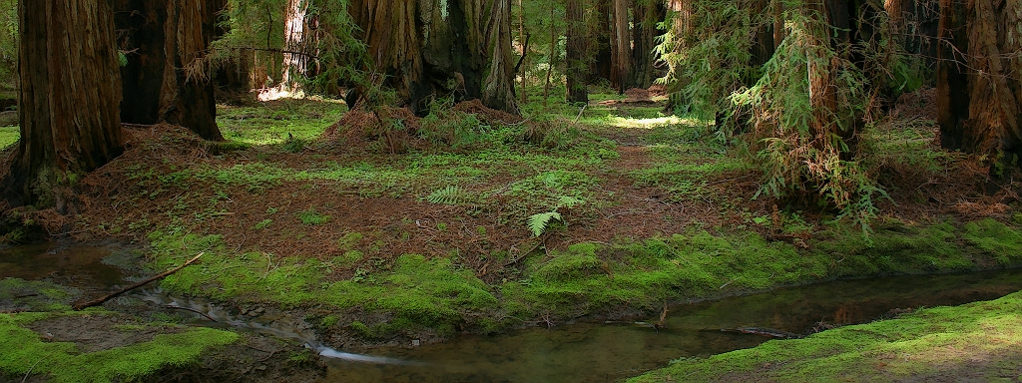
forestFloor
Seeing the curvature of the random forest
Søren H Welling, Line K Clemmensen, Lars Hovgaard, Per Brockhof, Stephen T Buckley, Hanne F Refsgaard

Slide 20
How to learn from the machine
Sample
data
Have machine
to model data
Unknown
system
Learn from
model
Bottom-up model selection
Unknown
system
Sample data
Fit e.g.
linear regression
Look at residuals
Add more terms or transformations
Test hypotheses of G
Simple model
Best model
G

Slide 21


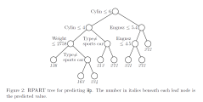
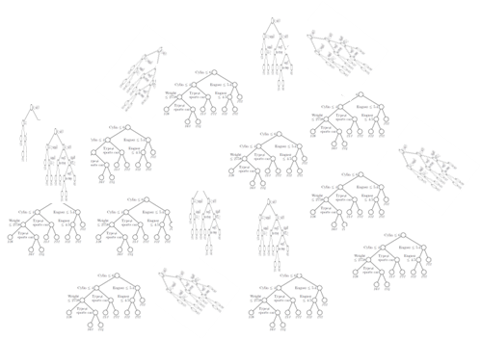

Slide 22
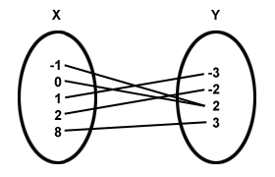
Architecture vs mapping
View tree

Slide 23
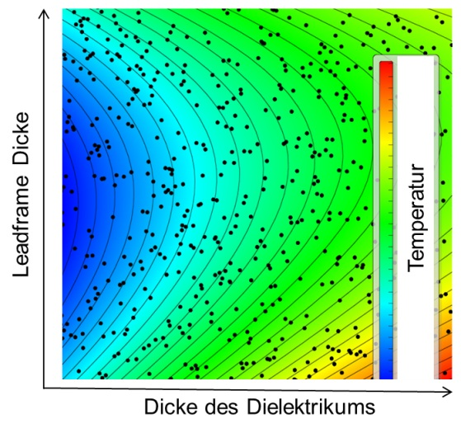
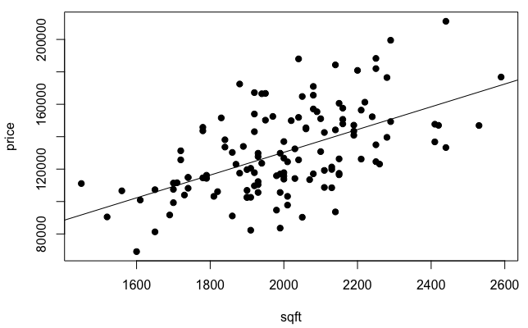
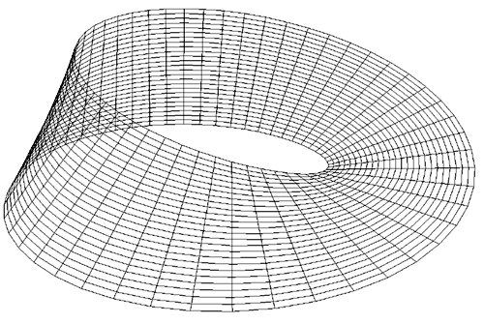
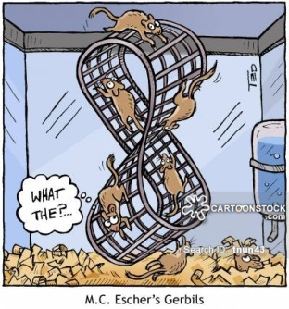
2D
3D
House prices

Slide 24
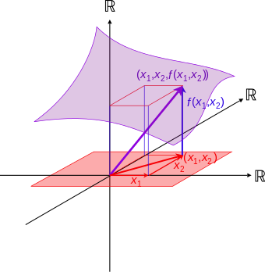
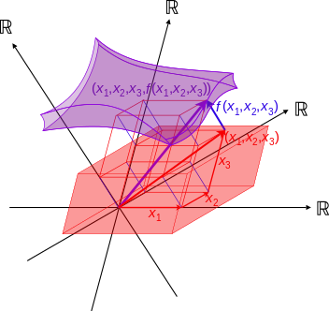
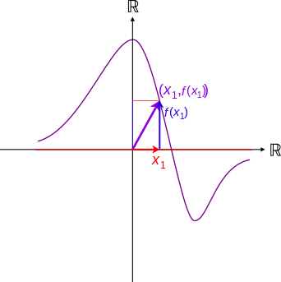
Visualizing mapping
2D
3D
4D

Slide 25
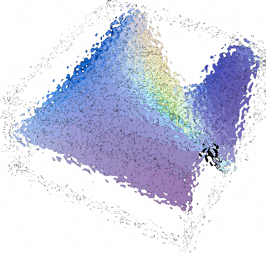
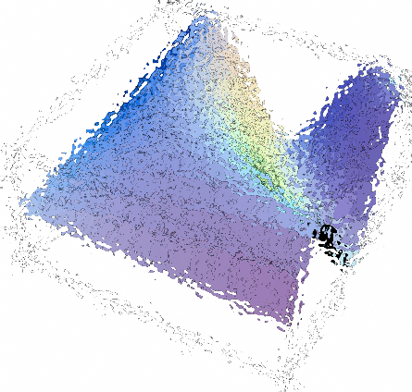
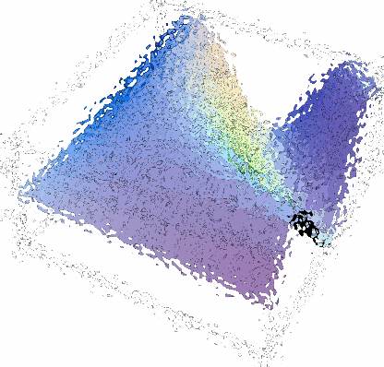
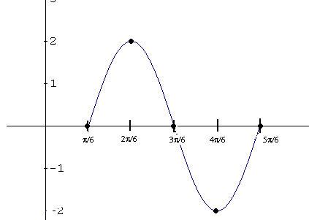
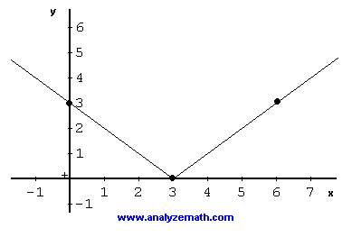
splitting model map in components
h₁(x₁)
h₂(x₂)
P+1 dimensions
=
+
+ …
x₁
x₂
algorithm finds h_{i} such that…
Main effects: f(X) = ∑_{p}h_{i}(x_{i}) + J_{o>1} (X)

Slide 26
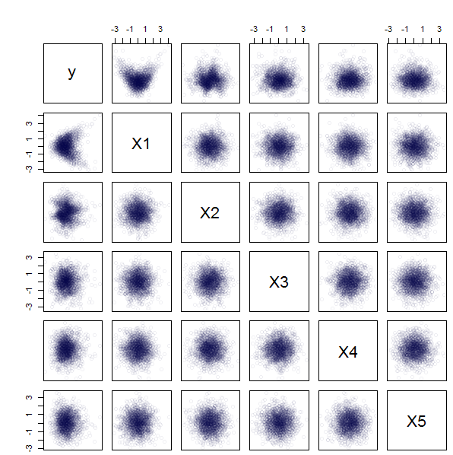
Dear algorithm, figure this one out

Slide 27
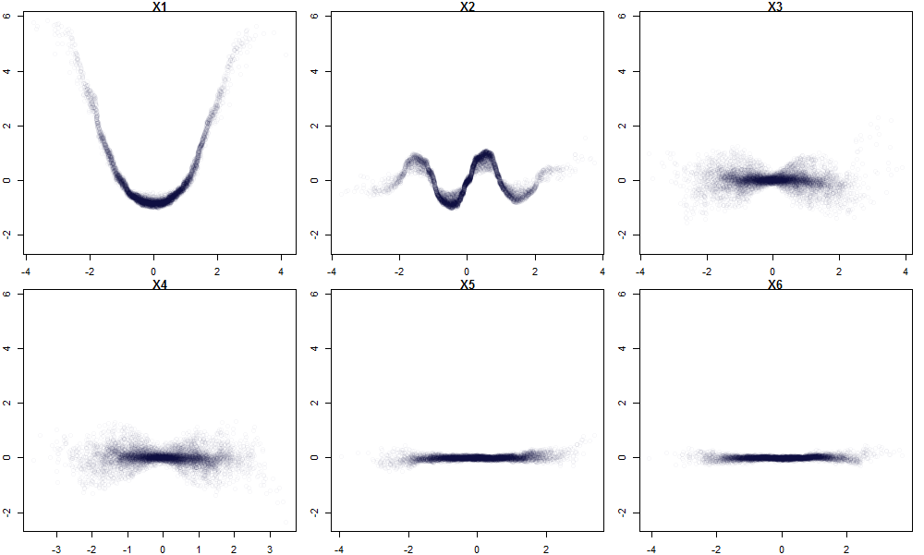
The solution is…
$Y=G^{∗}\left(X\right)={\left(x_{1}\right)}^{2}+sin\left(x_{2}\right)+ \left(x_{3} ∙ x_{4}\right)+{0x}_{5}+0x_{6}$ + noise
x₁²
sinx₂
X₃(x)₄
X₄(x)₃

Slide 28
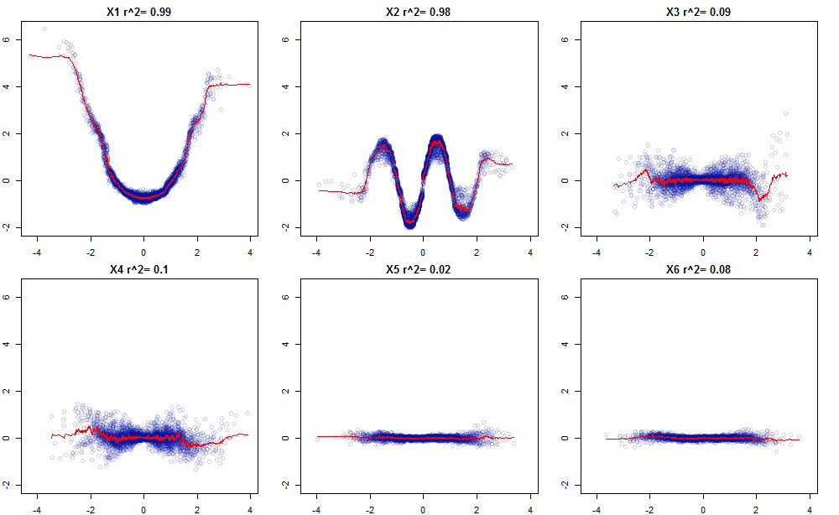

Slide 29
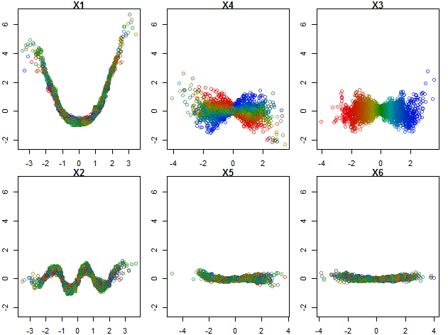

Slide 30
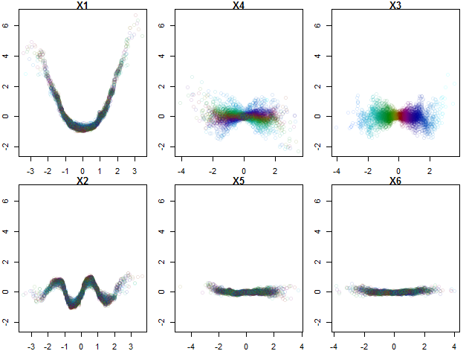

Slide 31

Click me for 3D

Slide 32
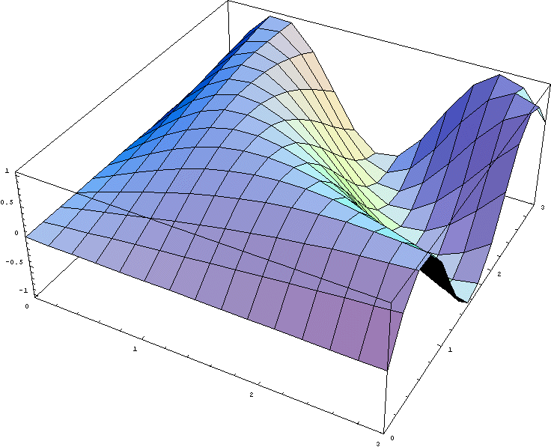
splitting model map in components
h₂₄(x_{2,} x₄)
h₁₂(x_{1,} x₂)
h₁₃(x_{1,} x₃)
=
+
+
2nd order effects: f(X) = ∑_{p}∑_{p}h_{ij}(X_{ij}) + J_{o>2} (X)

Slide 33
Don’t worry the mapping is rarely that complex
Less likely
f(X) = ∑_{p} ∑_{p}∑_{p}h_{ijk}(X_{ijk}) + J_{o>3} (X)
…because N<10.000
…and random forest is not that flexible

Slide 34
How are the individual components estimated?

Slide 35
ū₇=12
n= 52
ū₁=0.14
n=200
10
ū₃=10
n=82
X1 <= 0.8
X1 > 0.8
X₂ <= 1
X₂ > 1
ū₂=-7
n=118
ū₃=10
n=82
ū₆=6.5
n= 32
X₁ > 0.25
X₁ <= 0.25
X₁ <= 0.8
X₁ > 0.8
X₂ > 1
X₂ <= 1
ū₁=0.14
n=200
ū₆=6.5
n= 32
ū₇=12
n= 52
0
ū₄=-10
n=67
ū₅=-3
n=51
obs | X1 | X2 | FC1 | FC2 | Y
1 (LL) | 0.1 | 0.1 | -3-(-7) = 4 | -7-0.14 = -7.14 | 0.14+4-7.14 = -3
2 (UR) | 0.9 | 0.9 | 12-10 = 2 | 10-0.14 = 9.86 | 0.14+2+9.86 = 12
3 (UL) | 0.1 | 0.9 | 6.5-10 = -3.5 | 10-0.14 = 9.86 | 0.14-3.5-9.86 = 6.5
4 (LR) | 0.9 | 0.1 | -10-(-7) = -3 | -7-0.14 = -7.14 | 0.14-3-7.14 = -10
ū₅=-3
n=51
ū₂=-7
n=118
X₁ <= 0.25
X₁ > 0.25
-10
ū₄=-10
n=67

Slide 36
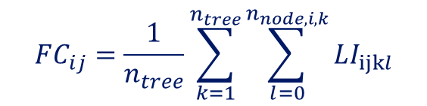
$$FC_{ij}=\frac{1}{n_{tree}}\sum_{k=1}^{n_{tree}}{\sum_{l=0}^{n_{node,i,k}}{LI_{ijkl}}}$$
Feature contribution, FC
Local increment, LI
Any sample, i
Any variable, j
Any tree, k
Any node of the i’th pathway in the
K’th tree, l

Slide 37
Sample
data
Have machine
to model data
Unknown
system
Look at main effects
Identify interactions
With colour gradient
Plot interactions
when needed

Slide 38
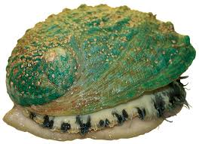
Y:
Rings / integer / -- / +1.5 gives the age in years
Model precision +/- 3 years
But how?
X: Sex / nominal / M, F, and I (infant) Length / continuous / mm / Longest shell measurement Diameter / continuous / mm / perpendicular to length Height / continuous / mm / with meat in shell Whole weight / continuous / grams / whole abalone Shucked weight / continuous / grams / weight of meat Viscera weight / continuous / grams / gut weight (after bleeding) Shell weight / continuous / grams / after being dried

Slide 39
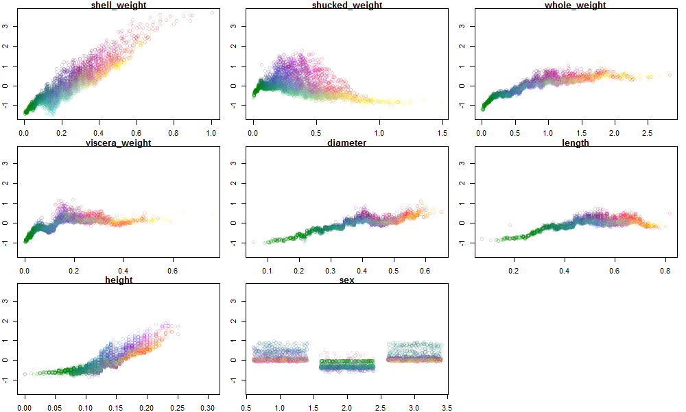

Slide 40
Is forestFloor the only method to slice with?
More vec-plotting

Slide 41
What about classification?
?
?
?
?

Slide 42
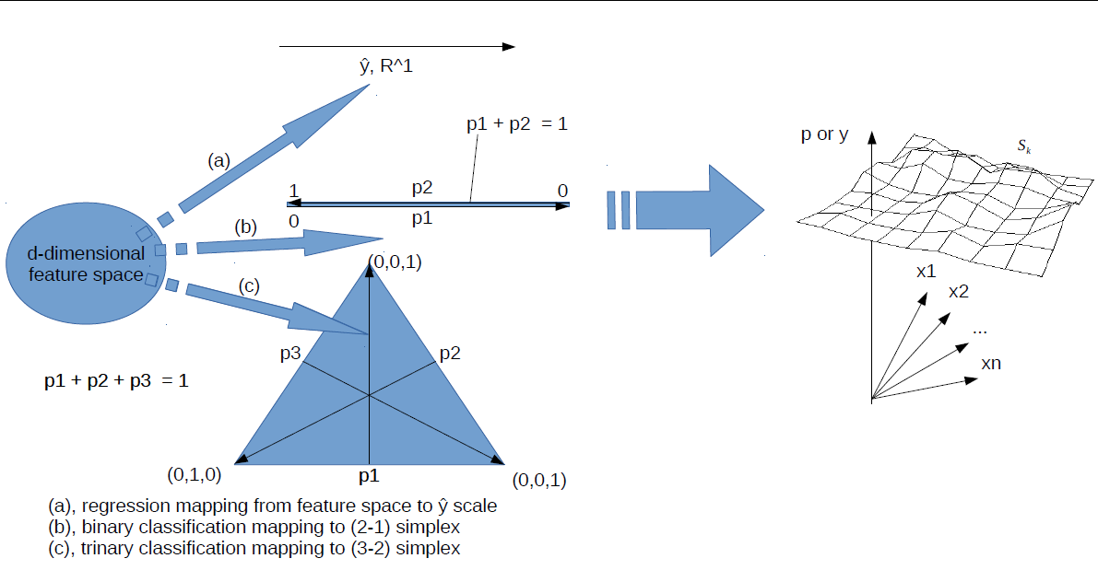

Slide 43
2D
3D
House prices

Slide 44
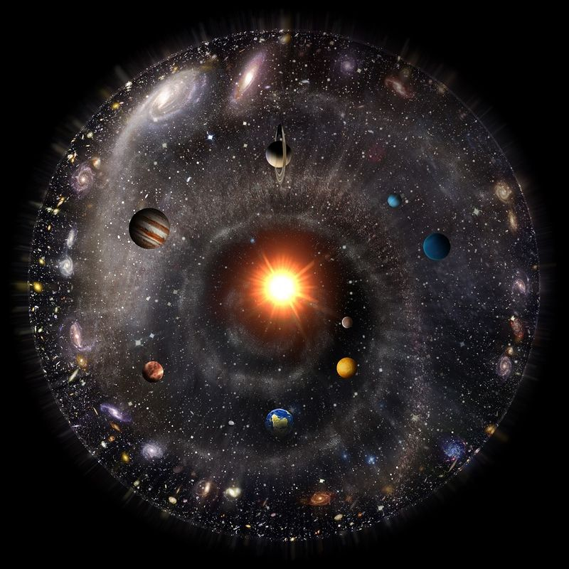
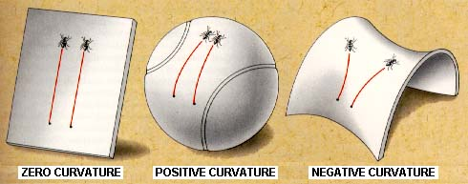

High dimensional / non-euclidean geometry

Slide 45



What is the depth of RF?
Continuous / many levels
Binary / two levels
$$y=\prod_{1}^{N}{x_{i}}$$

